Slide 1

Sentiment Analysis of Indian Political Tweets
Team details:
Team No-A3
Sl No | Name | Roll No | USN
1 | Swati Bhat | 155 | 01FE22BCS273
2 | Vidhi Patel | 154 | 01FE22BCS269
3 | Om R Muddapur | 153 | 01FE22BCS262
4 | Chandanagouda B H | 161 | 01FE22BCS287

Slide 2
Contents
Sl No | Contents | Slide no
01 | Introduction | 3
02 | Motivation | 4
03 | Problem Statement & Objectives | 5
04 | Dataset Description | 7
05 | Methodology | 10
06 | Experimental Results | 13
07 | Conclusion | 16

Slide 3

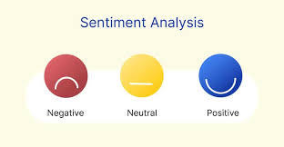
Sentiment Analysis
Definition and Purpose: Sentiment analysis is an NLP task that identifies and categorizes the emotional tone of text into predefined categories like positive, negative, or neutral. It is widely used to understand public opinion, customer feedback, and social media trends.
Applications and Importance: Sentiment analysis plays a significant role in politics by helping gauge public sentiment on policies and campaigns. In research, it is used to analyze opinions in large datasets. By automating sentiment evaluation, organizations can make data-driven decisions more effectively and respond to audience needs in real time.

Slide 4
Sentiment Analysis
Motivation:
Indian political discourse on platforms like X (formerly Twitter) generates a wealth of public opinion data.
Existing sentiment analysis models are not tailored to India's diverse cultural, regional and linguistic contexts.
Lack of prior research combining advanced deep learning techniques like LSTM and RNN with effective feature extraction methods (TF-IDF, Word2Vec) for Indian political sentiment.
Importance for policymakers, researchers, and analysts to understand public sentiment for better decision-making.

Slide 5
Sentiment Analysis
Problem Statement:
Sentiment Analysis of Indian Political Tweets: A Comparative Study with LSTM and RNN Model

Slide 6
Sentiment Analysis
Objectives:
To uncover the subtle layers of sentiment, emotional undertones, and evolving trends in Indian political discourse.
To utilize advanced text representation methods like TF-IDF and Word2Vec for meaningful feature extraction from textual data.
To employ deep learning models, specifically LSTM and RNN, to analyze sequential data and capture contextual and temporal refinements in political tweets.
To provide actionable insights for policymakers, researchers, and analysts to better understand public sentiment and inform decision-making and governance strategies.

Slide 7
Sentiment Analysis
Data Description:
Source of Data:
Dataset collected from Kaggle.
Consists of 50,000 Indian political tweets.
Content of Dataset:
Includes tweets with details such as:
Posting date
User information
Engagement metrics (likes, retweets).
Preprocessing:
Removed stop words, usernames, and punctuation.
Case-folding applied for uniform text.
Eliminated duplicates and irrelevant columns (e.g., date, user details).

Slide 8
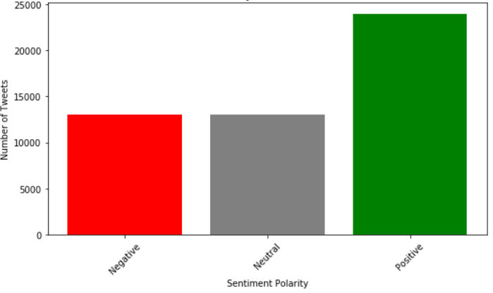
Sentiment Analysis
Data Description:
4. Labeling:
The dataset was unlabeled initially.
Sentiment polarity calculated using TextBlob:
Positive: 24,000 tweets
Neutral: 15,000 tweets
Negative: 13,000 tweets
5. Purpose:
Analyze the sentiment of Indian political discourse using deep learning models like LSTM and RNN.
Features extracted using advanced techniques like TF-IDF and Word2Vec.
Fig. 3. Sentiment polarity vs Number of Tweets

Slide 9
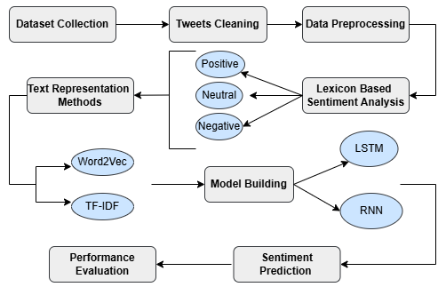
Sentiment Analysis
Workflow:
Fig. 4. Workflow: Step-by-step process for sentiment analysis of political tweets

Slide 10
Sentiment Analysis
Methodology:
Data Preprocessing:
Cleaning tweets (removing stop words, special characters, etc.).
Tokenizing using NLTK's 'punkt' tokenizer.
Feature Extraction:
TF-IDF: Measures word importance relative to the dataset.
Word2Vec: Generates semantic word embeddings.
Model Training:
Train LSTM and RNN models using the processed data
Evaluate models using metrics like accuracy, precision, and recall.

Slide 11
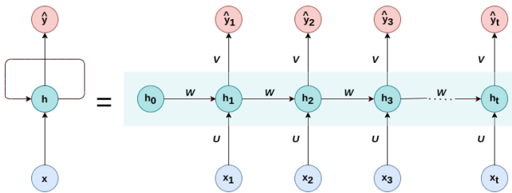
Sentiment Analysis
Recurrent Neural Network(RNN):
RNN is a class of artificial neural networks designed to process sequential data by retaining contextual information through their recurrent structure. They are widely used for tasks like language modeling, speech recognition, and sentiment analysis.
How RNN Works:
Input Processing: At each time step, RNN takes the current input and the hidden state from the previous time step as inputs.
Hidden State Update: The hidden state is updated using the current input and past hidden states to capture sequential dependencies.
Output Generation: The network produces an output at each time step, influenced by both the current input and the sequence history.
Why RNN for Sentiment Analysis?
Captures Context: RNNs can model dependencies in sequential data, such as the flow of sentiments in text.
Real-Time Analysis: Useful for analyzing short and fragmented texts like tweets, where the order of words impacts meaning.
Fig. 1. A simple Recurrent Neural Network

Slide 12
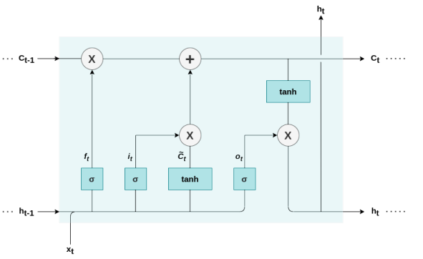
Sentiment Analysis
Long Short-Term Memory(LSTM):
LSTM is a specialized type of Recurrent Neural Network (RNN) designed to overcome the challenges of traditional RNNs, particularly when handling sequential data like time series, text, or speech.
How LSTM Works:
Input Processing: The model processes input at each time step while retaining relevant past information in its memory cell.
Decision Making: At each step, LSTM evaluates:
What information is important to keep or forget.
How this impacts the next steps in the sequence.
Why LSTM for Sentiment Analysis?
Handles Context: Retains and understands contextual dependencies in textual data, essential for complex sentiments.
Effective for Long Sequences: Perfect for political tweets or discussions involving subtle opinions spanning multiple sentences.
Fig. 2. The internal structure of a single hidden unit in an LSTM.

Slide 13
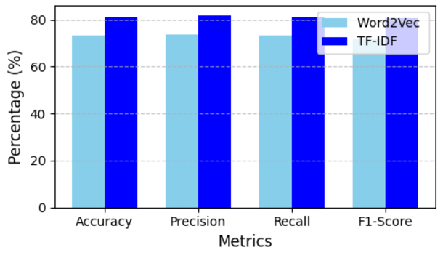
Sentiment Analysis
Results:
LSTM with TF-IDF and Word2Vec
The LSTM model performs significantly better with TF-IDF than Word2Vec across all metrics, indicating that TF-IDF effectively captures key features of the Indian political dataset, while Word2Vec struggles to capture specific details and context.
Fig. 5. Performance metrics of LSTM in %

Slide 14
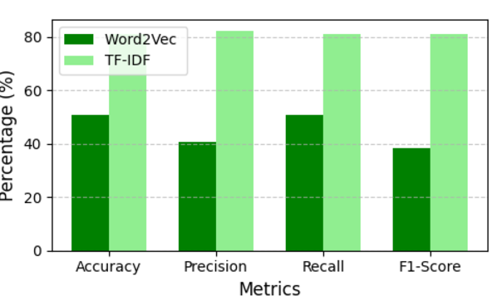
Sentiment Analysis
Results:
RNN with TF-IDF and Word2Vec
The RNN model demonstrates better performance with TF-IDF than Word2Vec across all metrics. This indicates that TF-IDF is more effective for representing features in the Indian political tweets' dataset, as it helps the RNN focus on important terms more effectively than Word2Vec. These findings highlight TF-IDF as the preferred choice for sentiment analysis in this context.
Fig.6. Performance metrics of RNN in %

Slide 15
Sentiment Analysis
Results:
TABLE 1:
TESTING ACCURACY OF MODELS WITH DIFFERENT TECHNIQUES
Observations:
LSTM with TF-IDF achieved the highest accuracy: 83.02%.
RNN with TF-IDF also performed well (81.06%) but less than LSTM.
Word2Vec embeddings were less effective compared to TF-IDF for both models.
Models | Word2Vec Accuracy(%) | TF-IDF Accuracy(%)
LSTM | 73.08 | 83.02
RNN | 50.7 | 81.06

Slide 16
Sentiment Analysis
Conclusion:
Objective of the Study: The research compares LSTM and RNN models for sentiment analysis on Indian political tweets.
Key Results:
LSTM with TF-IDF achieves the highest accuracy (83.02%), outperforming Word2Vec (73.08%) and RNN paired with either TF-IDF (81.06%) or Word2Vec (50.7%).
TF-IDF proves highly effective in capturing contextual word importance.
LSTM demonstrates superior performance over RNN in modeling sequential dependencies.
Conclusion: The study concludes that LSTM combined with TF-IDF outperforms other model-feature combinations, achieving the highest accuracy in sentiment analysis of Indian political tweets. This emphasizes the importance of choosing the right feature extraction and model architecture for optimal results.

Slide 17
Sentiment Analysis
References:
[1] C. Duncombe, “The politics of twitter: Emotions and the power of social media,” International Political Sociology, vol. 13, pp. 409–429, 08 2019.
[2] S. Madakam and S. Tripathi, “Social media/networking: Applications, technologies, theories,” Journal of Information Systems and Technology Management, vol. 18, 06 2021.
[3] C. Park, “Does twitter motivate involvement in politics? tweeting, opinion leadership, and political engagement,” Computers in Human Behavior, vol. 29, p. 1641–1648, 07 2013.
[4] P. Research, “Political content on social media.” https://www. pewresearch.org/political-content-social-media-2021/, 2021. [Online; accessed 30-Nov-2024].
[5] S. Qaiser and R. Ali, “Text mining: Use of tf-idf to examine the relevance of words to documents,” International Journal of Computer Applications, vol. 181, 07 2018.
[6] C.-z. Liu, Y.-x. Sheng, Z.-q. Wei, and Y.-Q. Yang, “Research of text classification based on improved tf-idf algorithm,” pp. 218–222, 08 2018.
[7] D. Jatnika, M. Bijaksana, and A. Ardiyanti, “Word2vec model analysis for semantic similarities in english words,” Procedia Computer Science, vol. 157, pp. 160–167, 01 2019.
[8] G. Van Houdt, C. Mosquera, and G. N´apoles, “A review on the long short-term memory model,” Artificial Intelligence Review, vol. 53, 12 2020.

Slide 18
Thank You!!

